Slide 1
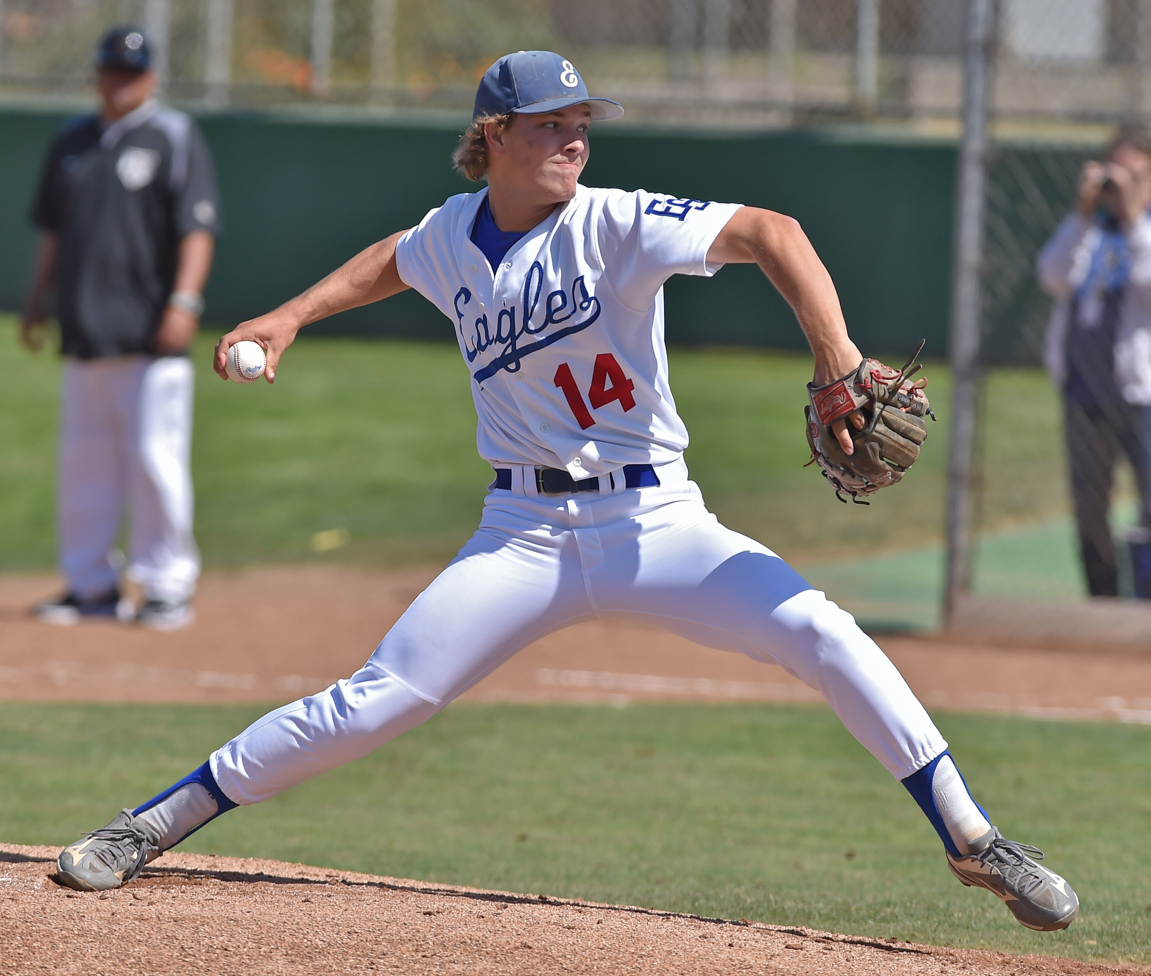
PITCHING (Part 2) & PENALTY or AWARD (Part 2)
Rule 6; Section 2: Articles 1-5

Slide 2
Rule 6, Section 2 - Infractions By Pitcher (Part 2)
ART. 1 . . . Illegal acts include:
a. applying a foreign substance to the ball;
b. spitting on the ball or glove;
c. rubbing the ball on the glove, clothing or person if the act defaces the ball;
d. discoloring the ball with dirt;
e. bringing the pitching hand in contact with the mouth without distinctly wiping off the pitching hand before it touches the ball;
f. wearing any items on the hands, wrists or arms that may be distracting to the batter;
g. wearing or placing tape, bandages or other foreign material (other than rosin) on the fingers or palm of his pitching hand that could come in contact with the ball;
h. wearing a glove/mitt that includes the colors white or gray;
i. wearing exposed undershirt sleeves that are white or gray.
NOTE: Under umpire supervision, the pitcher may dry his hands by using a finely meshed cloth bag of powdered rosin. He may rub the ball with his bare hands to remove any extraneous coating.
PENALTY: For defacing the ball (a-d), the ball is dead immediately. The umpire may eject the pitcher. If such defaced ball is pitched and then detected, it is an illegal pitch. For infraction (e), a ball shall be awarded each time a pitcher violates this rule and subsequently engages the pitching plate. For infraction (f-i), the infraction must be corrected before the next pitch. In (f), the umpire has sole authority to judge whether an item is distracting and shall have that item removed.
ART. 2 . . . Delay of the game includes:
a. throwing to any player other than the catcher, when the batter is in the batter’s box, unless it is an attempt to retire a runner;
PENALTY: The pitcher shall be ejected from the game after a warning.
b. consuming time as the result of the coach or his representative conferring with a defensive player or players after being charged with three conferences (3-4-1);
PENALTY: The pitcher shall be replaced as pitcher for the duration of the game.
c. failing to pitch or make or attempt a play, including a legal feint, within 20 seconds after he has received the ball.
PENALTY: The batter shall be awarded one ball.
NOTE: Umpires shall require that the ball be returned promptly to the pitcher.

Slide 3
Rule 6, Section 2 - Infractions By Pitcher (Part 2) Cont.
EXCEPTION: The starting pitchers may warm up by using not more than eight throws, completed in one minute (timed from the first throw). When a pitcher is replaced during an inning or prior to an inning, the relief pitcher may not use more than eight throws completed in one minute (timed from the first throw). At the beginning of each subsequent inning, the pitcher may warm up by using not more than five throws, completed in one minute (timed from the third out of the previous half-inning) (3-1-2). In either case, the umpire-in-chief may authorize more throws because of an injury, ejection or inclement weather.
ART. 3 . . . Intentionally pitch close to a batter.
PENALTY: The pitcher shall be ejected if the act is judged to be - intentional. In case of doubt, the umpire may first warn the pitcher.
ART. 4 . . . Balk. If there is a runner or runners, any of the following acts by a pitcher while he is touching the pitcher’s plate is a balk:
a. any feinting toward the batter or first base, or any dropping of the ball (even though accidental) and the ball does not cross a foul line (6-1-4);
b. failing to step with the non-pivot foot directly toward a base (occupied or unoccupied) when throwing or feinting there to put out, or drive back a runner; or throwing or feinting to any unoccupied base when it is not an attempt to put out or drive back a runner;
c. making an illegal pitch from any position (6-1, 6-2-1a-d); d. failing to pitch to the batter in a continuous motion immediately after any movement of any part of the body such as he habitually uses in his delivery;
1. If the pitcher, with a runner on base, stops or hesitates in his delivery because the batter steps out of the box (a) with one foot or (b) with both feet or (c) holds up his hand to request “Time,” it shall not be a balk. In (a) and (c), there is no penalty on either the batter or the pitcher. The umpire shall call “Time” and begin play anew. In (b), a strike shall be called on the batter for violation of 7- 3-1. In (a), (b) and (c), if the pitcher legally delivers the ball, it shall be called a strike and the ball remains live. Thus, two strikes are called on the batter in (b). If the umpire judges the batter’s action to be a deliberate attempt to create a balk, he will penalize according to 3-3-1n.

Slide 4
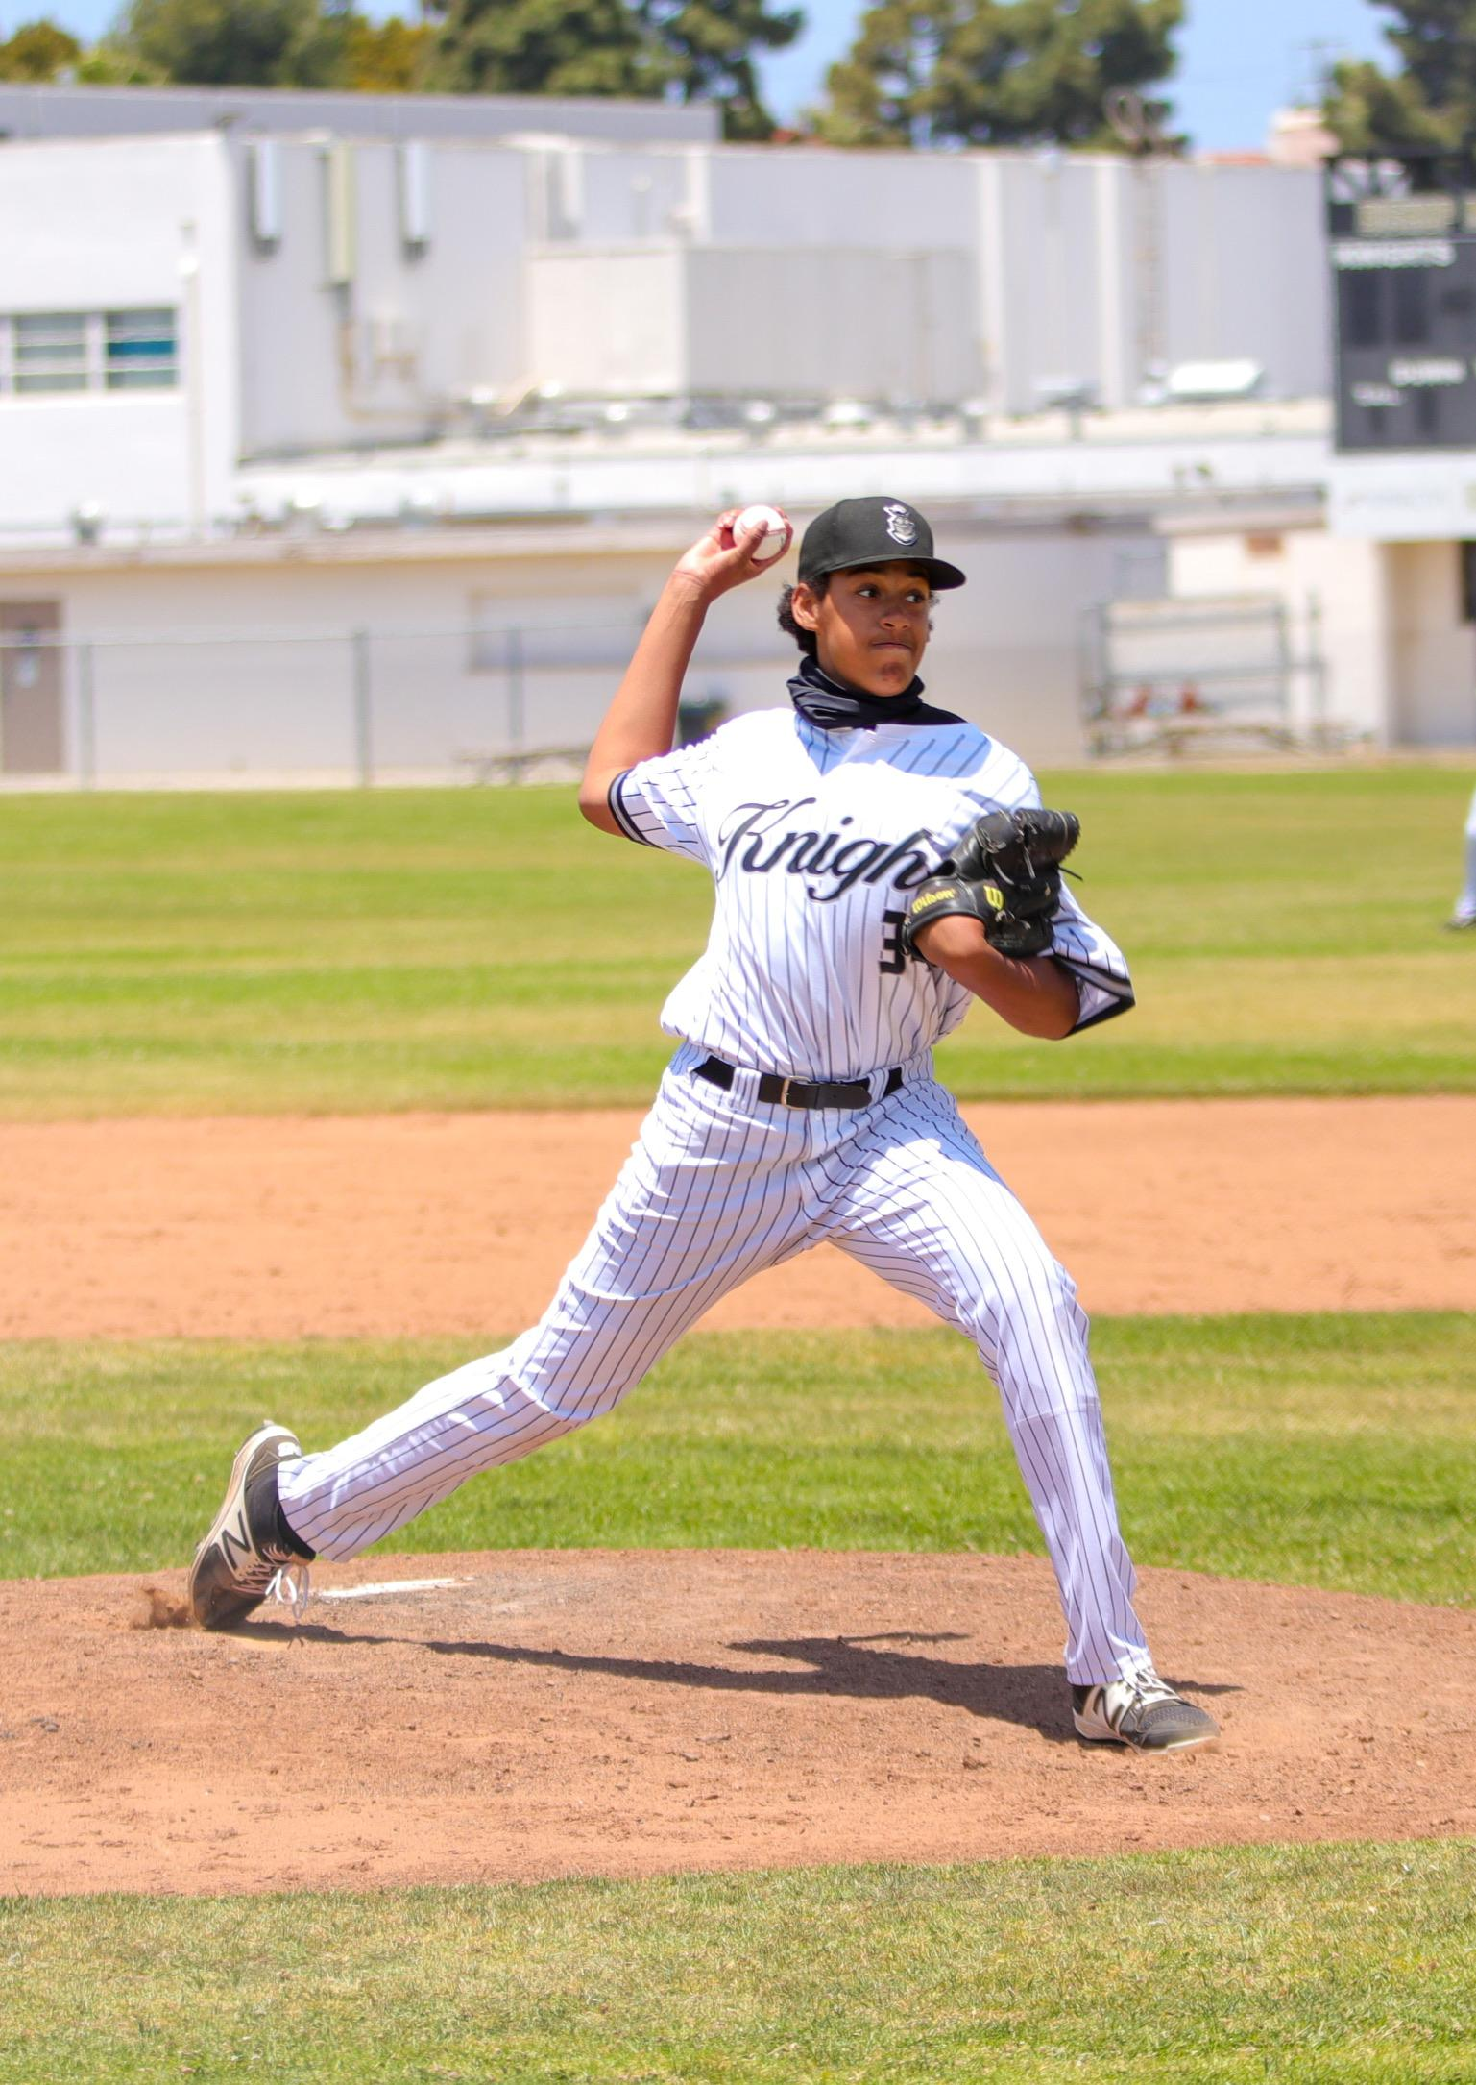
Rule 6, Section 2 - Infractions By Pitcher (Part 2) Cont.
e. taking a hand off the ball while in a set position (6-1-3), unless he pitches to the batter or throws to a base, or he steps toward and feints a throw to second or third base as in (b); or
f. failing to pitch to the batter when the entire non- pivot foot passes behind the perpendicular plane of the back edge of the pitcher’s plate, except when feinting or throwing to second base in an attempt to put out a runner.
ART. 5 . . . It is also a balk if a runner or runners are on base and the pitcher, while he is not touching the pitcher’s plate, makes any movement naturally - associated with his pitch, or he places his feet on or astride the pitcher’s plate, or positions himself within approximately five feet of the pitcher’s plate without having the ball.

Slide 5
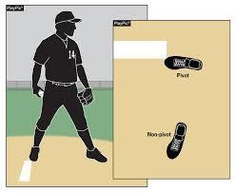
Toss-up Study Guide Questions and Discussion -
58. Pitcher F1 is wearing a black solid-colored wristband on his glove-side arm for the purpose of taking signs from either the dugout or his catcher. Legal?
A. Not Legal, F1 cannot wear a wristband for any purpose while pitching
B. Not Legal, F1 has to wear that on his belt if he elects to use it
C. Legal provided that the head coach notified the plate umpire prior to the plate meeting
D. Legal provided that such wristband is not deemed to be distracting by the umpire
ANSWER: D References: Rule 1-4-2, 1-5-9, and 6-2-1-f Penalty & 2019 NFHS Interpretation #17
61.
A. Legal set position
B. Legal windup position
C. Illegal
ANSWER: A Reference: Rule 6-1-2

Slide 6
Defining the Balk
A balk is an illegal act committed by the pitcher with a runner(s) on base which entitles each runner to advance one base. Any of the following acts by a pitcher while he is touching the pitcher’s plate is a balk:
any feinting toward the batter or first base, or any dropping of the ball (even though accidental) and the ball does not cross a foul line
failing to step with the non-pivot foot directly toward a base (occupied or unoccupied) when throwing or feinting there in an attempt to put out, or drive back a runner; or throwing or feinting to any unoccupied base when it is not an attempt to put out or drive back a runner; “direction and gain distance”
making an illegal pitch from any position
failing to pitch to the batter in a continuous motion immediately after any movement of any part of the body such as he habitually uses in his delivery
If the pitcher, with a runner on base, stops or hesitates in his delivery because the batter steps out of the box (a) with one foot or (b) with both feet, or (c) holds up his hand to request “Time,” it shall not be a balk. In (a) and (c), there is no penalty on either the batter or the pitcher. The umpire shall call “Time” and begin play anew. In (b), call a strike on the batter (violation for not keeping at least one foot in the batter’s box throughout the time at bat). In (a), (b) and (c), if the pitcher legally delivers the ball, call a strike and the ball remains live. Thus, call two strikes on the batter in (b). If the umpire judges the batter’s action to be a deliberate attempt to create a balk, he will eject the player.
taking a hand off the ball while in a set position, unless he pitches to the batter, or throws to a base, or he steps toward and feints a throw to second or third base as in (b)
failing to pitch to the batter when the entire non-pivot foot passes behind the perpendicular plane of the back edge of the pitcher’s plate, except when feinting or throwing to second base in an attempt to put out a runner
It is also a balk if a runner or runners are on base and the pitcher, while he is not touching the pitcher’s plate, makes any movement naturally associated with his pitch, or he places his feet on or astride the pitcher’s plate, or positions himself within approximately five feet of the pitcher’s plate without having the ball.

Slide 7
Penalty or Award (Part 2) . . .
Number of Bases | Determined at time of:
One Base (runners)
Balk | Infraction
Throw or pitch from pitcher’s plate thrown out of play | Pitch/Throw
Throw from pitcher’s plate goes out of play | Throw
Unintentional catch and carry (i.e., fielder steps or falls with both feet from field of play) | Pitch
Number of Bases | Determined at time of:
*Catcher obstruction (if attempting to advance, i.e., stealing) | Pitch – Delayed Dead Ball
Forced (because batter is awarded 1st base) | Pitch
Pitch strikes runner (except when pitch is a strike for third out) | Pitch
Pitch lodges in defensive player’s or umpire’s uniform or equipment | Pitch
Number of Bases | Determined at time of:
One Base (batters)
Walk | Pitch
Pitch thrown out of play on ball four | Pitch
*Defense obstructs batter | Pitch – Delayed Dead Ball
Hit by pitch (except when he permits the ball to touch him, or pitch is a strike) | Pitch
Runner interference (unintentional) | Pitch
Umpire interference (hit by batted ball) | Pitch
Two Bases (batters & runners)
Fair batted ball bounces over, through, goes under, lodges in, or under fence | Pitch
#Fair batted ball or thrown ball lodges in defensive player’s or umpire’s uniform or equipment (except ball lodged in glove) | Pitch

Slide 8
Penalty or Award (Part 2) . . .
Number of Bases | Determined at time of:
Two Bases (batters & runners cont.)
*#Live thrown ball or pitch touched by illegal glove or mitt | Infraction (Delayed Dead Ball)
*#Live thrown ball or pitch touched by detached player equipment which is thrown, tossed, kicked or held by fielder | Infraction (Delayed Dead Ball)
First throw by infielder and ball goes out of play or lodged in or under fence | Pitch
For any subsequent play by an infielder or for any throw by an outfielder and ball goes out of play or lodges in or under fence. | Throw
Intentional catch and carry (runners only) | Pitch
Three Bases (batters & runners cont.)
Fair batted ball (or over foul ground which might become fair) contacted with detached player equipment or illegal glove/mitt | Infraction (Delayed Dead Ball)
Four Bases (batters & runners cont.)
Fair batted ball over fence in flight or prevented by spectator or player’s detached equipment | Pitch
Fair batted ball hits foul pole above fence in flight | Pitch
Number of Bases | Determined at time of:
Umpires’ Judgment
Spectator interference | Infraction
*Runner(s) obstruction (minimum of one base). If obstructed runner and all other runners hindered by the obstruction do not reach bases they otherwise would have reached, award runner or runners such bases. | Infraction (Delayed Dead Ball)
Defensive malicious contact | Infraction
NOTES:
* Award only if not ignoring infraction (i.e., batter and all runners attempting to steal or who are forced advance to appropriate bases) | Delayed Dead Ball
#Only make an award to the batter-runner on a pitch if he has the right to advance to first base.

