Slide 1
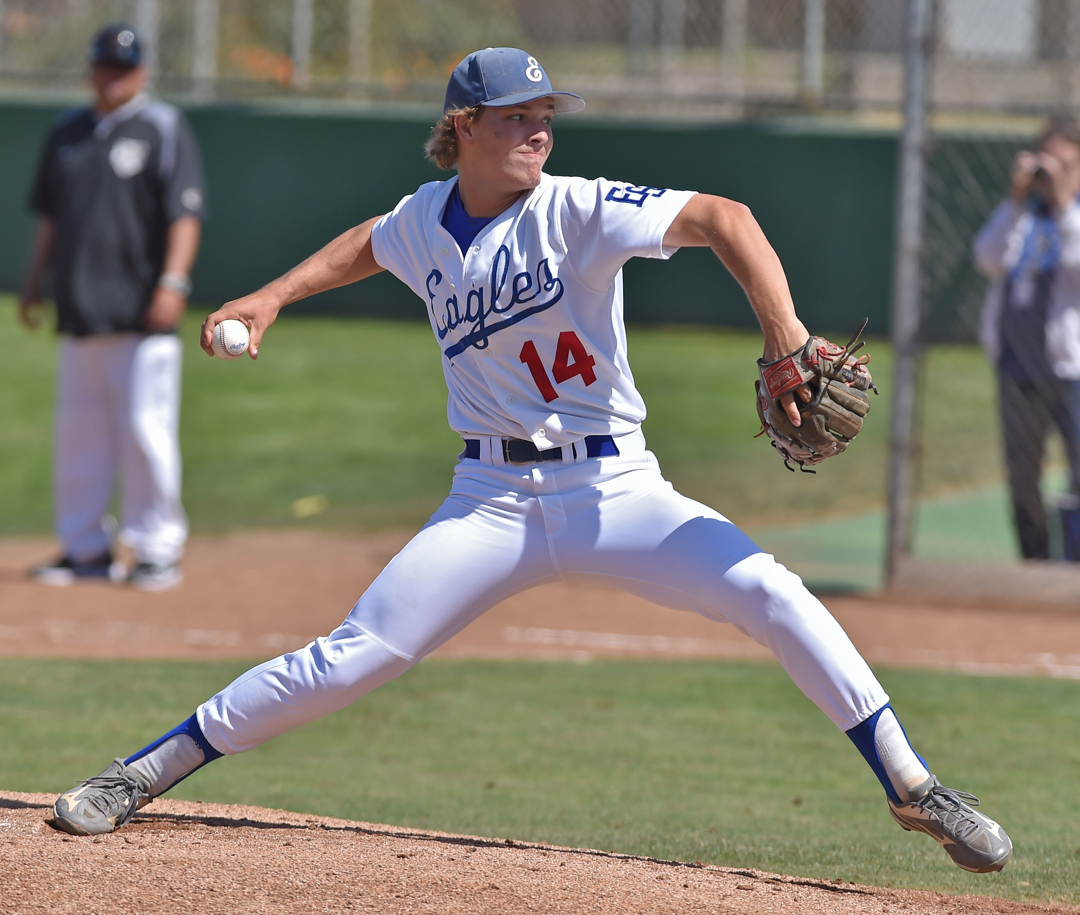
PITCHING (Part 1) & PENALTY or AWARD (Part 1)
Rule 6; Section 1: Articles 1-6

Slide 2
Rule 6, Section 1 Pitching (Part 1)
ART. 1 . . . The pitcher shall pitch while facing the batter from either a windup position (Art. 2) or a set position (Art. 3). The position of his feet determine whether he will pitch from the windup or the set position. He shall take his sign from the catcher with his pivot foot in contact with the pitcher’s plate. The pitching regulations begin when he intentionally contacts the pitcher’s plate. Turning the shoulders to check runners while in contact with the pitcher’s plate in the set position is legal. Turning the shoulders after bringing the hands together during or after the stretch is a balk. He shall not make a quick-return pitch in an attempt to catch a batter off balance. The catcher shall have both feet in the catcher’s box at the time of the pitch. If a pitcher is ambidextrous, the umpire shall require the pitcher to face a batter as either a left-handed pitcher or right-handed pitcher, but not both.
ART. 2 . . . For the wind-up position, the pitcher is not restricted as to how he shall hold the ball. A pitcher assumes the windup position when his hands are: (a) together in front of the body; (b) both hands are at his side; (c) either hand is in front of the body and the other hand is at his side. The pitcher’s non-pivot foot shall be in any position on or behind a line extending through the front edge of the pitcher’s plate.
ART. 2 Cont. . . . He is limited to not more than two pumps or rotations. After he starts his movement to pitch, he must continue the motion without interruption or alteration. With his feet in the wind-up position, the pitcher may only deliver a pitch or step backward off the pitcher’s plate with his pivot foot first. After the pitcher has placed his pivot foot clearly behind the plate, he has the right to change to the set position or throw or feint to a base the same as that of any infielder. During delivery, he may lift his non-pivot foot in a step forward, a step sideways, or in a step backward and a step forward, but he shall not otherwise lift either foot.
ART. 3 . . . For the set position, the pitcher shall have the ball in either his gloved hand or his pitching hand. His pitching hand shall be down at his side or behind his back. Before starting his delivery, he shall stand with his entire non-pivot foot in front of a line extending through the front edge of the pitcher's plate and with his pivot foot in contact with or directly in front of and parallel to the pitcher's plate. He shall go to the set position without interruption and in one continuous motion. He shall come to a complete and discernible stop (a change of direction is not considered an acceptable stop) with the ball in both hands in front of the body and his glove at or below his chin. Natural preliminary motions such as only one stretch may be made.

Slide 3
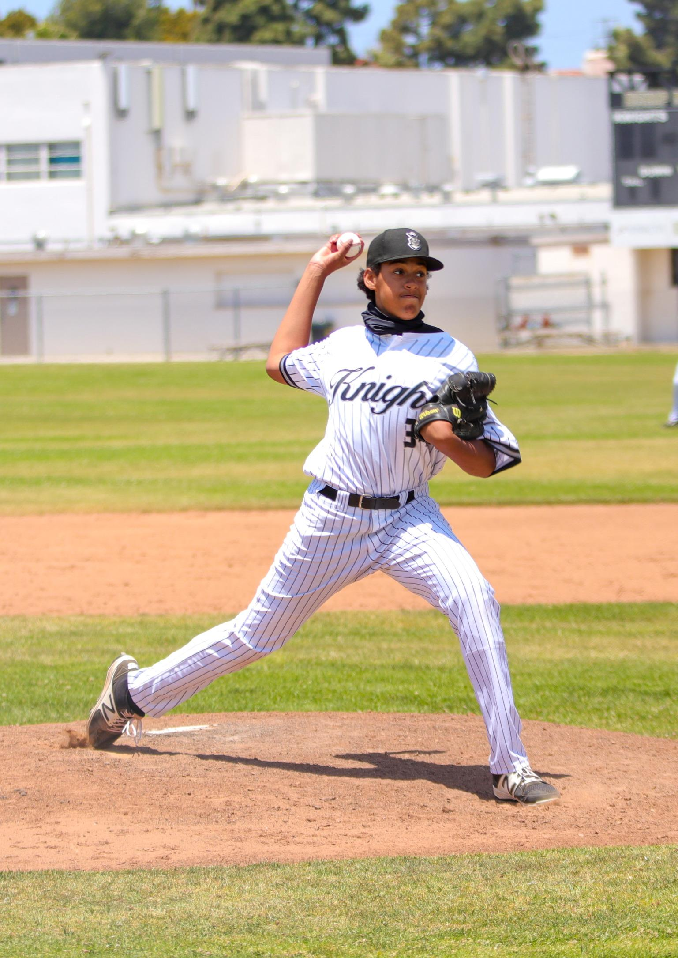
Rule 6, Section 1 Pitching (Part 1)
ART. 3 Cont. . . . During these preliminary motions and during the set position until a delivery motion occurs, the pitcher may turn on his pivot foot or lift it in a jump turn to step with the non-pivot foot toward a base while throwing or feinting as outlined in 6-2-4 and 2-28-5, or he may lift his pivot foot in a step backward off the pitcher's plate which must be in or partially within the 24-inch length of the pitcher's plate. In order to change to the wind-up position, he must first step clearly backward off the pitcher's plate with his pivot foot first. After the pitcher has placed his pivot foot on the ground clearly behind the plate, he then has the right to throw or feint to a base the same as that of any other infielder.
Penalty: (Arts. 1, 2, 3) . . . The ball is dead immediately when an illegal pitch occurs. If there is no runner, a ball is awarded the batter. If there is a runner, such illegal act is a balk. In both situations, the umpire signals dead ball.
ART. 4 . . . Each legal pitch shall be declared by the umpire as a strike, ball, fair or foul hit or a dead ball. A pitch dropped during delivery, and which crosses a foul line shall be called a ball. Otherwise, it will be called no pitch. A pitch dropped during delivery with at least one runner on base would be a balk if it does not cross a foul line.

Slide 4
Toss-up Study Guide Questions and Discussion -
5. The head coach from Team A presents a lineup at the plate meeting, and it is reviewed, confirmed, and accepted as official by the plate umpire. In the 3rd inning the head coach from Team A tells the plate umpire that a player from his team that was not on the lineup has arrived at the field and he wants to add him to the lineup and insert him into the game.
Illegal. The late-arriving player cannot be added to the lineup once it has been accepted by the plate umpire.
Legal. The late arriving is added to the list of available substitutes, and then substituted into the game. The head coach for Team A is issued a written warning.
Legal. The late arriving is added to the list of available substitutes, and then substituted into the game. The head coach for Team A is ejected.
Legal. The late arriving is added to the list of available substitutes, and then substituted into the game without penalty to Team A.
Rule Reference: 1-1-2
42. B1 is batting with an 0-0 count and the bases loaded. F1 is in the wind-up position with the ball in his bare hand down by his side and his empty glove down by his other side. After getting the sign, F1 begins his pitching motion by now bringing his ball hand and glove together in front of him and stops for one second in this position. F1 then continues his windup and delivers the pitch, which is taken for a called ball.
This is a legal play. Bases remain loaded and the count is now 0-1.
This is a balk because the pitcher started and then stopped his delivery. Award R3 home on the balk and all other runners are awarded one base. The count is now 1-0.
This is a balk because the pitcher started and then stopped his delivery. Award R3 home and all other runners one base. Count remains at 0-0.
None of the above are correct.
Reference: Rule 6-1-1, 6-1-2, 6-1-3

Slide 5
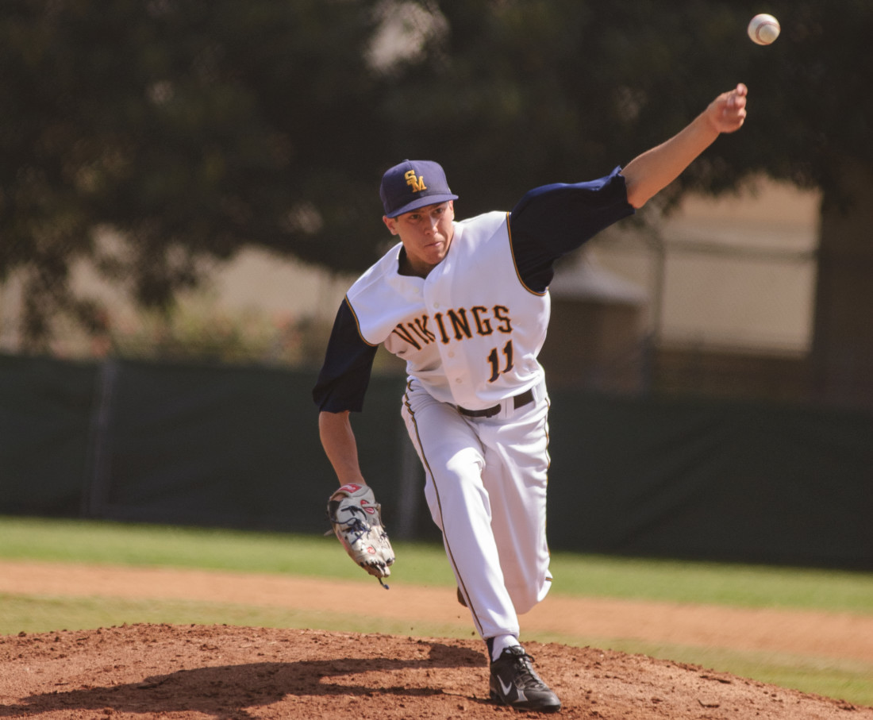
Rule 6, Section 1 Pitching (Part 1)
ART. 5 . . . When a pitcher is attempting to field a batted or thrown ball or is throwing to a base while his pivot foot is clearly off his plate, his status is that of an infielder except that if a batted ball passes, but does not touch him and then strikes an umpire or a runner, the ball may become dead because of interference (8-4-2g, 8-4-2k).
ART. 6 . . . Each state association shall have a pitching restriction policy based on the number of pitches thrown to afford pitchers a required rest period between pitching appearances. (Whose job is it to count pitches in CIF-SS?)
Case Book – 6.1.1 SITUATION K: While off the pitching plate, the pitcher looks into the dugout and receives a signal for the next pitch. The pitcher next, legally steps onto the pitching plate, looks at the catcher, and then delivers a legal pitch. The opposing coach insists that a balk should be called because the pitcher did not take his “sign” from the catcher.
RULING: There is no balk. A pitcher is required, once on the pitching plate, to take or simulate taking his sign from the catcher. While the pitcher took his pitching sign from the dugout, he did simulate taking a sign from the catcher. No violation!

Slide 6
Penalty or Award (Part 1) . . .
Situation | Penalty or Award
8-Players: Playing with eight (8) players Note: Must start the game with at least nine (9) players | Call an out each time that spot in the batting order comes to bat. If the coach substitutes for the offensive player after reaching base, the most recent batter not on base runs for that player.
Loose equipment: Loose equipment interferes with play | May call an out(s), award bases, or return runners, based on judgment and the circumstances concerning the play.
Proper equipment: Proper equipment not worn | If a player fails to wear proper equipment after an umpire orders them to, eject the player.
Pre-Game Conference: Head coach refuses to attend the pregame conference | Restrict the coach to the dugout for the remainder of the game.
Warnings/Ejections: A coach, player, substitute, etc. shall not: leave the dugout during a live ball for an unauthorized purpose fake a tag without the ball carelessly throw a bat wear jewelry (players participating in the game) or wear bandannas hit the ball to players on defense after the game has started | At the end of playing action, First offense: Team Warning. Subsequent violation: Ejection. Note: If fake a tag without the ball, it is also obstruction.
Situation | Penalty or Award
(CONT) Warnings/Ejections: A coach, player, substitute, etc. shall not: commit any unsportsmanlike act to include, but not limited to use of words or actions to incite or attempt to incite spectators - demonstrations use of profanity, intimidation tactics, remarks reflecting unfavorably upon any other person or taunting or baiting. The NFHS disapproves of any form of taunting use of any language intended to intimidate behavior in any manner not in accordance with the spirit of fair play being in live ball territory (excluding team’s bullpen area) during the opponent’s infield practice prior to the start of the game any member of the coaching staff who is not the head coach (or designee) leaving the vicinity of the dugout or coaching box to dispute a judgment call by an umpire | Warn the offender; Any offense judged to be major in nature shall result in an immediate ejection. For coaches who violate f (1-5), g, h, i, j or k, issue a warning or eject the offender. For violation of f(6) both the head coach and offending coach shall receive a written warning or ejection. In f(7), the state association shall determine appropriate action.

Slide 7
Penalty or Award (Part 1) . . .
Situation Cont. | Penalty or Award
Confronting or directing unsportsmanlike conduct to the umpires after the game has concluded and until the umpires have departed the game site enter the area behind the catcher while the opposing pitcher and catcher are in their positions use of any object in his possession in the coach’s box other than a stopwatch, rule book (hard copy), scorebook be outside the designated dugout (bench) or bullpen area if not a batter, runner, on-deck batter, in the coach’s box or one of the nine players on defense charge an umpire use amplifiers or bullhorns for coaching purposes during the course of the game | Warn the offender; Any offense judged to be major in nature shall result in an immediate ejection. For coaches who violate f (1-5), g, h, i, j or k, issue a warning or eject the offender. For violation of f(6) both the head coach and offending coach shall receive a written warning or ejection. In f(7), the state association shall determine appropriate action.
Situation | Penalty or Award
Warnings/Ejections: A coach, player, substitute, etc. shall not: commit any unsportsmanlike act to include, but not limited to use of words or actions to incite or attempt to incite spectators - demonstrations use of profanity, intimidation tactics, remarks reflecting unfavorably upon any other person or taunting or baiting. The NFHS disapproves of any form of taunting use of any language intended to intimidate behavior in any manner not in accordance with the spirit of fair play being in live ball territory (excluding team’s bullpen area) during the opponent’s infield practice prior to the start of the game any member of the coaching staff who is not the head coach (or designee) leaving the vicinity of the dugout or coaching box to dispute a judgment call by an umpire | Eject the offender. Failure to comply shall result in a forfeit. In (m), the ball is immediately dead, if on offense, eject the player and declare him out, unless he has already scored. If the defense commits the malicious contact, eject the player; the umpire shall rule either safe or out on the play and award the runner(s) the appropriate base(s) he felt they would have obtained if the malicious contact had not occurred.

Slide 8
Penalty or Award (Part 1) . . .
Defensive
Situation | Penalty or Award
A fielder (except catcher) with no feet touching fair ground | Illegal pitch (No runners on base = ball to batter; runners on base = balk).
Illegal pitch: Illegal pitch (no runner) | Rule the pitch a ball.
Illegal substitute on defense | Player restricted to the dugout for the duration of the game. If involved in a play, the team on offense has the option to let the play stand or to allow the batter to bat again.
Conferences: After three (3) charged conferences in a seven-inning game, or for any charged conference in excess of one in each extra inning | Pitcher removed as pitcher for duration of the game.
The starting pitcher does not face one batter | He may play another position, but not return to pitch.
Situation | Penalty or Award
Illegal acts [by a pitcher]: Illegal acts [by a pitcher] include: applying a foreign substance to the ball spitting on the ball or glove rubbing the ball on the glove, clothing, or person if the act defaces the ball discoloring the ball with dirt bringing the pitching hand in contact with the mouth without distinctly wiping off the pitching hand before it touches the ball wearing any items on the hands, wrists or arms that may be distracting to the batter wearing or placing tape, bandages, or other foreign material (other than rosin) on the fingers or palm of his pitching hand that could come in contact with the ball wearing a glove/mitt that includes the colors white or gray wearing exposed undershirt sleeves that are white or gray | For defacing the ball (a-d), the ball is dead immediately. The umpire may eject the pitcher. If the pitcher pitches such defaced ball and then the umpire detects it, the pitch is illegal. For infraction (e), award a ball each time a pitcher violates this rule and subsequently engages the pitching plate. For infraction (f-i), correct the infraction before the next pitch. In (f), the umpire has sole authority to judge whether an item is distracting and shall have that item removed.

